Slide 1
‘Every customer counts’ Promoting accessible services
Equality Commission Northern Ireland
Employers for Disability
Disabled Access Day 10 March 2016
Brenda Puech, NRAC, Access Consultant

Slide 2
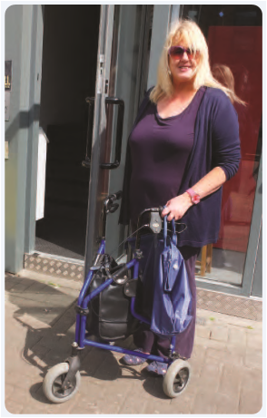
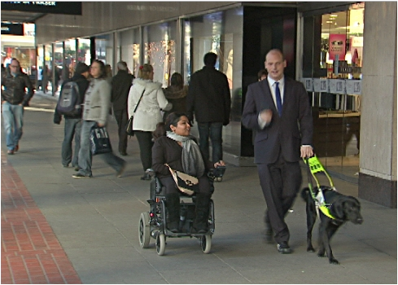
The market you cannot ignore
They are 360,000 of them in Northern Ireland and 20% of the population
They spend £212 billion a year in the UK
They are often responsible for household spending as well
They are demanding and will quickly walk away if they don’t get good service
They have money to spend when they get the service and products they need
They are loyal and will come back again and again
They are influential in how their friends and relatives buy products and services.
These people are all disabled
.

Slide 3
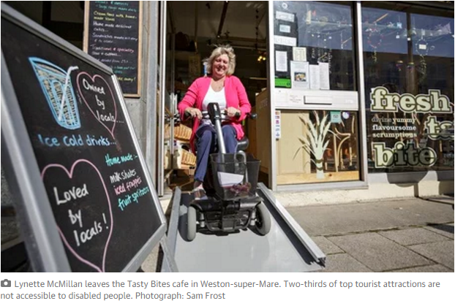
The Walk Away £
They are informed customers who will reward good customer service and reject businesses who don’t make any effort to meet their needs
75% of disabled people had ‘walked away’ from making a purchase due to inaccessible premises.
2/3^{rds} say they go back to businesses where they have received a good disability customer service.
Businesses need to tell disabled people about accessibility of their products and services
Business Disability Forum and RADAR survey into opinions and shopping habits of disabled customers, 2012.
Notes:
Business Disability Forum and RADAR did a survey into opinions and shopping habits of disabled customers.

Slide 4
Where do disabled people find it the hardest to spend their money?

Slide 5
Where do disabled people find it the hardest to spend their money?
Most difficult Finding shopping that is accessible
2nd hardest Going to cinemas and theatres
3rd hardest Eating out at pubs and restaurants
Source Dept of Work& Pensions DWP 2012

Slide 6
What did we find in businesses in Northern Ireland in 2014?

Slide 7
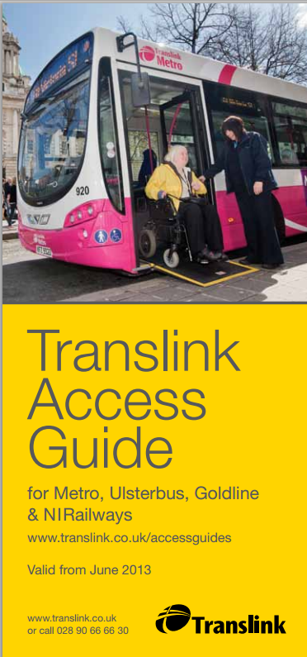
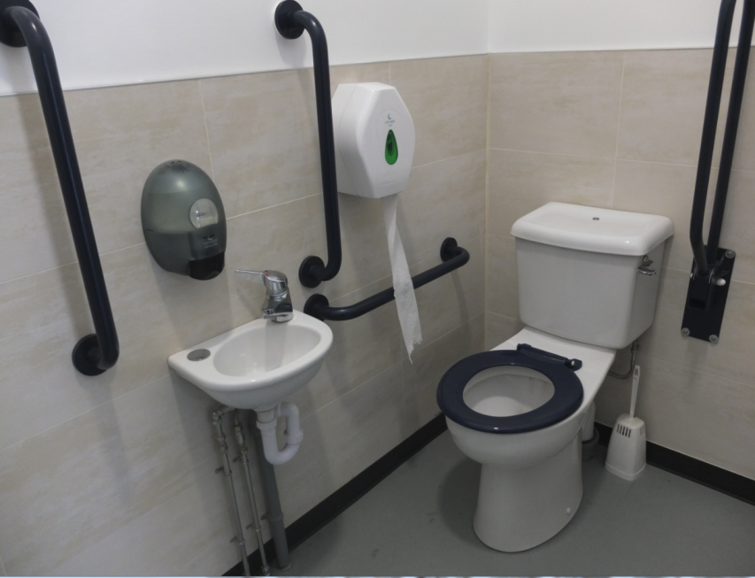
Accessible Translink
Accessible facilities at stations
Automatic entrance doors
Accessible lifts and staircases
Accessible counters, ticket machines, seating
Accessible toilets
Good visual contrast and use of tactile paving

Slide 8
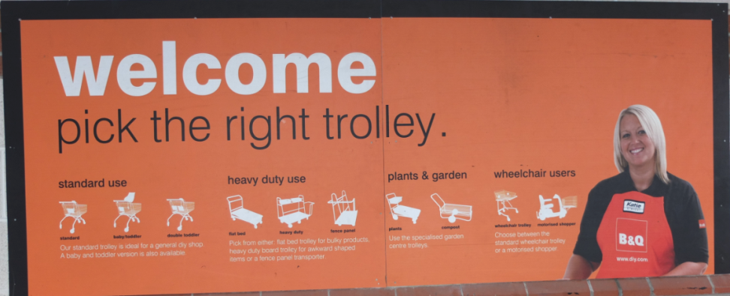
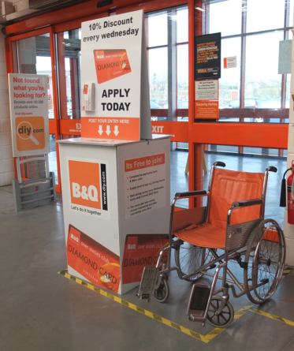
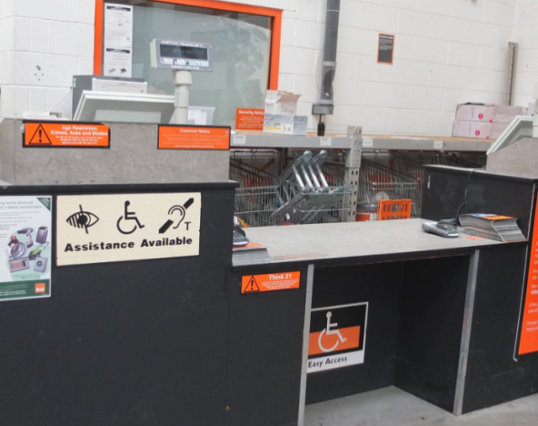
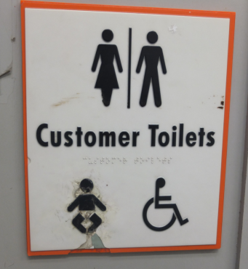
B & Q
Actively welcomes older and disabled customers
Provides manual wheelchairs
Provides trolleys to clip onto wheelchairs
Has a lowered counter for assistance and one at checkout, with an induction loop
Has accessible toilet
Good customer service

Slide 9
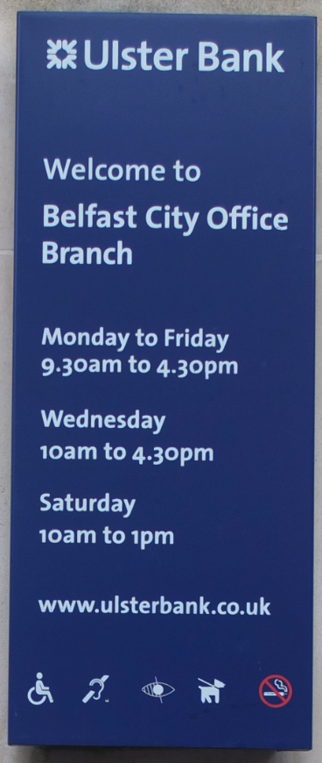
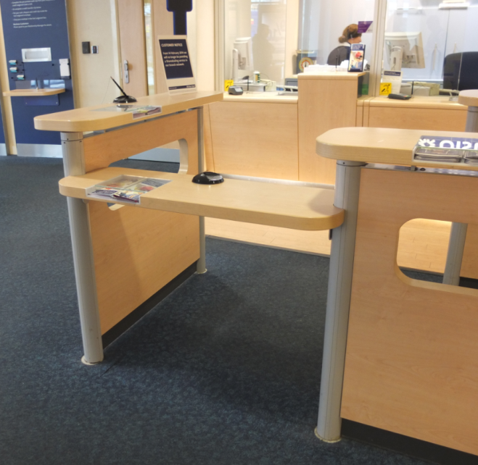
Ulster Bank, Belfast City
Step free wide entrance
Automatic doors
Excellent signage
Lowered writing tables
Lowered counters and induction loops
Good visual contrast

Slide 10
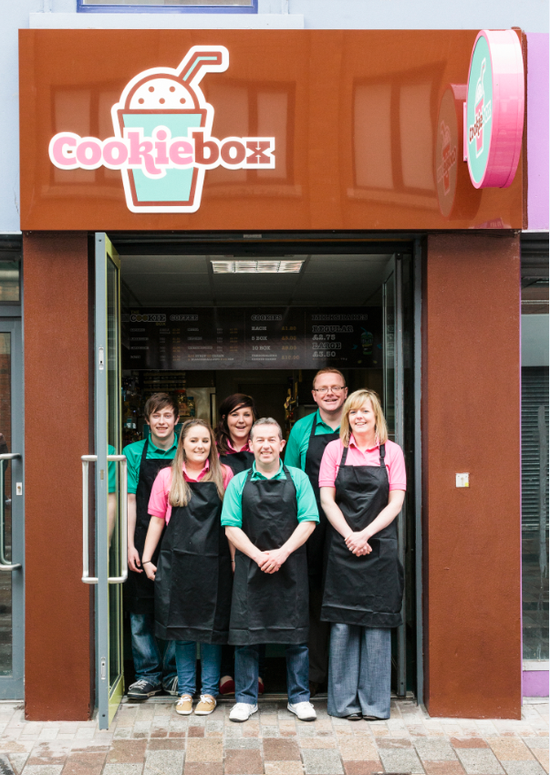
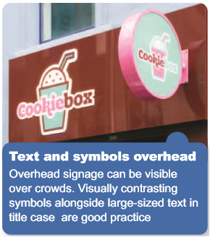
Cookiebox, Belfast
Word of Mouth – Great staff means great service
We asked locals who they would recommend:
‘A small business I think is excellent is The Cookie Box - they have a number of establishments There's one which has room to sit in - and although it is very small they're great at taking a chair away if it's needed to make space. Staff there are brilliantly trained and will talk directly to me, rather than the person with me.’
- Michaela
-

Slide 11
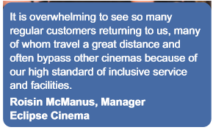
Eclipse Cinema
“We will most definitely be back”
‘The entrance and foyer are all level and the ramp into the theatre itself is almost level. There is a platform for wheelchairs in the centre of the theatre this is the perfect position to view the screen. To top it off the staff were friendly and helpful. It is an hour and a half drive but I think it’s worth it . 10/10’
Sean, Armagh -review on Tripadviser

Slide 12
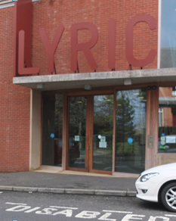
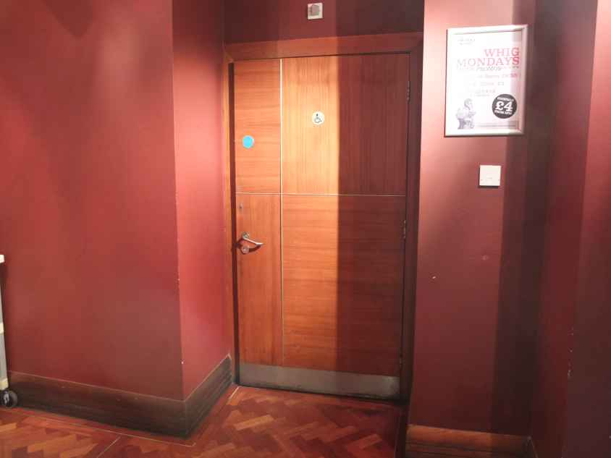
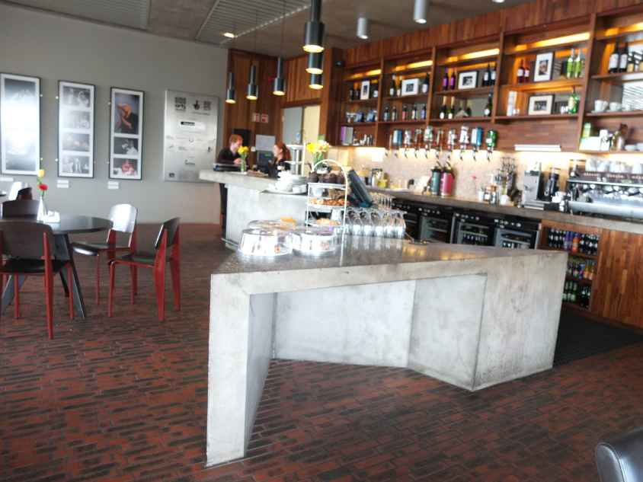
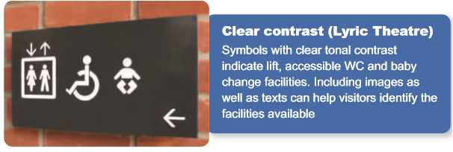
Lyric Theatre, Belfast
Accessible parking
Lower bar and dining counter
Mainly good signage
Mainly good visual contrast

Slide 13
Top tips 1 – Make it Easy
Make it easy for people to find you
Get a good online presence
Install clear overhead signage (not A-boards!)
Put safety markings on glass
Make it easy for people to get in
Get rid of steps or provide a ramp (even if portable)
Make doors wide and LIGHT TO OPEN with easy to use handles
If you cannot avoid steps – provide a handrail and sign
Remove obstacles that people could walk into
Welcome and make it easy for people with assistance dogs

Slide 14
Top tips 2
Make it easy for people to get around
You should be able to see directly from the entrance to the pay counter
Provide a clear line of travel to move around (without boxes on the floor)
Put products within reach
Make it easy for people to use facilities
Provide storage for mobility aids
Provide seating – with back and armrests
Provide accessible toilets
Make your fitting room large enough

Slide 15
Top tips 3
Make it easy to get hold of information
Install an induction loop at the counter for hard of hearing customers
Have a pen and paper ready to help
Make menus, price lists and information easy to read for everyone. Use large, simple font and good contrast
Have captions on any television screens
Train staff to read information to customers who cannot see well. Also use aids with pictures of your goods for those who cannot hear well or speak or who may have learning difficulties

Slide 16
Mind your language!
Best not to say!
Better to say
We welcome wheelchairs
Disabled entrance round the back
Toilet for disabled customers
Disabled Toilet
Disabled Car Parking
Disabled Lift
No dogs
Please ask for large print menus
We welcome wheelchair users
The main entrance should be accessible! Otherwise call it a ‘Step-free entrance’
Accessible toilet (for all customers and is kept unlocked)
Accessible parking
Lift to all floors
Assistance dogs welcome
Can say this, but all menus should be clear!

Slide 17
Top tips 4 – Good manners
Introduce yourself, let customers know you are available to help
Talk to the customer directly, not who they are with
Don’t be afraid to ask ‘Can I help?’ or ‘How can I help you?’
Be patient and ready to repeat or clarify something
Speak clearly and face-to-face to people who are lip-reading
Offer choice and dignity – don’t make assumptions - not everyone wants or needs help.

Slide 18
Top tips 5 – Provide up to date and accurate information
Know your facilities and services - where is the nearest accessible toilet?
Can you provide home visits, carry-to-car or delivery services? Are your menus, leaflets and information in a large and clear print?
Toilet, changing room or lift out of action? Let customers know. Make sure that your service and facilities information is online and up-to-date so visitors can plan ahead Save customers wasted journeys by forewarning them.

Slide 19
Top tips 6 – How to provide practical assistance
Offer to find or reach for items
Can you carry or put items aside?
Offer to describe items or help to read labels
Do you know how to use your induction loop, ramp and other access equipment?
Offer a seat to waiting customers or to rearrange furniture for people who are wheelchair users, have an assistance dog or mobility aid users
Turn any music down to improve communication

Slide 20
Marketing to disabled people 5 things to ensure when providing online information

Slide 21
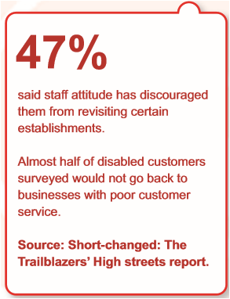
Reminders
Simple reasonable adjustments
Good customer service

