Slide 1
Tenant Participation Strategy
And Section 75
Shane Clements ECNI
DSD Housing Group 26th April 2016

Slide 2
Where to Start
Delivery Challenges
Current economic climate
Thinking and acting differently
New and innovative approaches to delivering objectives
New ways of working together
Blank piece of paper
Pre consultation work – tenants views
Discuss, listen, refine and repeat
The Formal Consultation Process

Slide 3
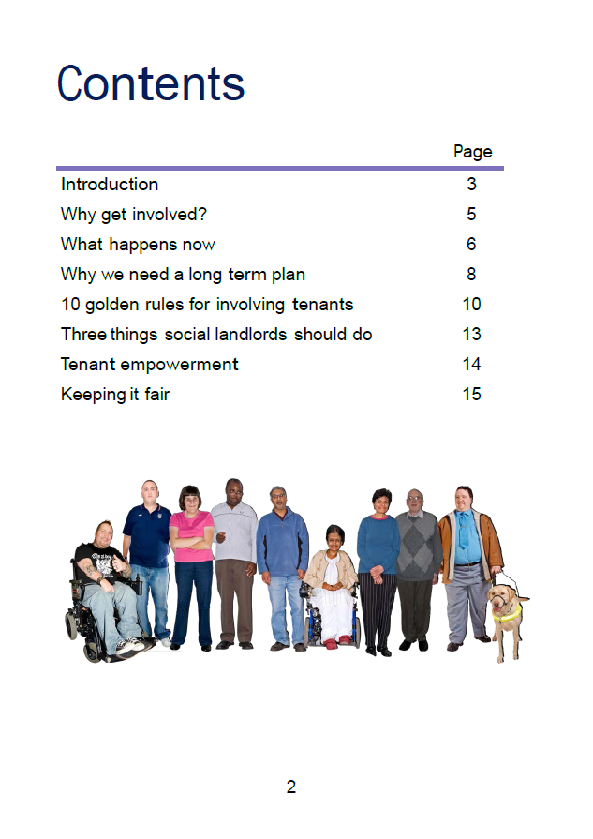
Lessons Learned
Delivery Challenges
Planning
Early contact pays off
Extend your reach
Narrow your reach
Hard to reach
Current economic climate
Thinking and acting differently
New and innovative approaches to delivering objectives
New ways of working together
Hard to reach – Easy to ignore

Slide 4
Delivery Challenges
Current economic climate
Thinking and acting differently
New and innovative approaches to delivering objectives
New ways of working together
THANK YOU

